Slide 1


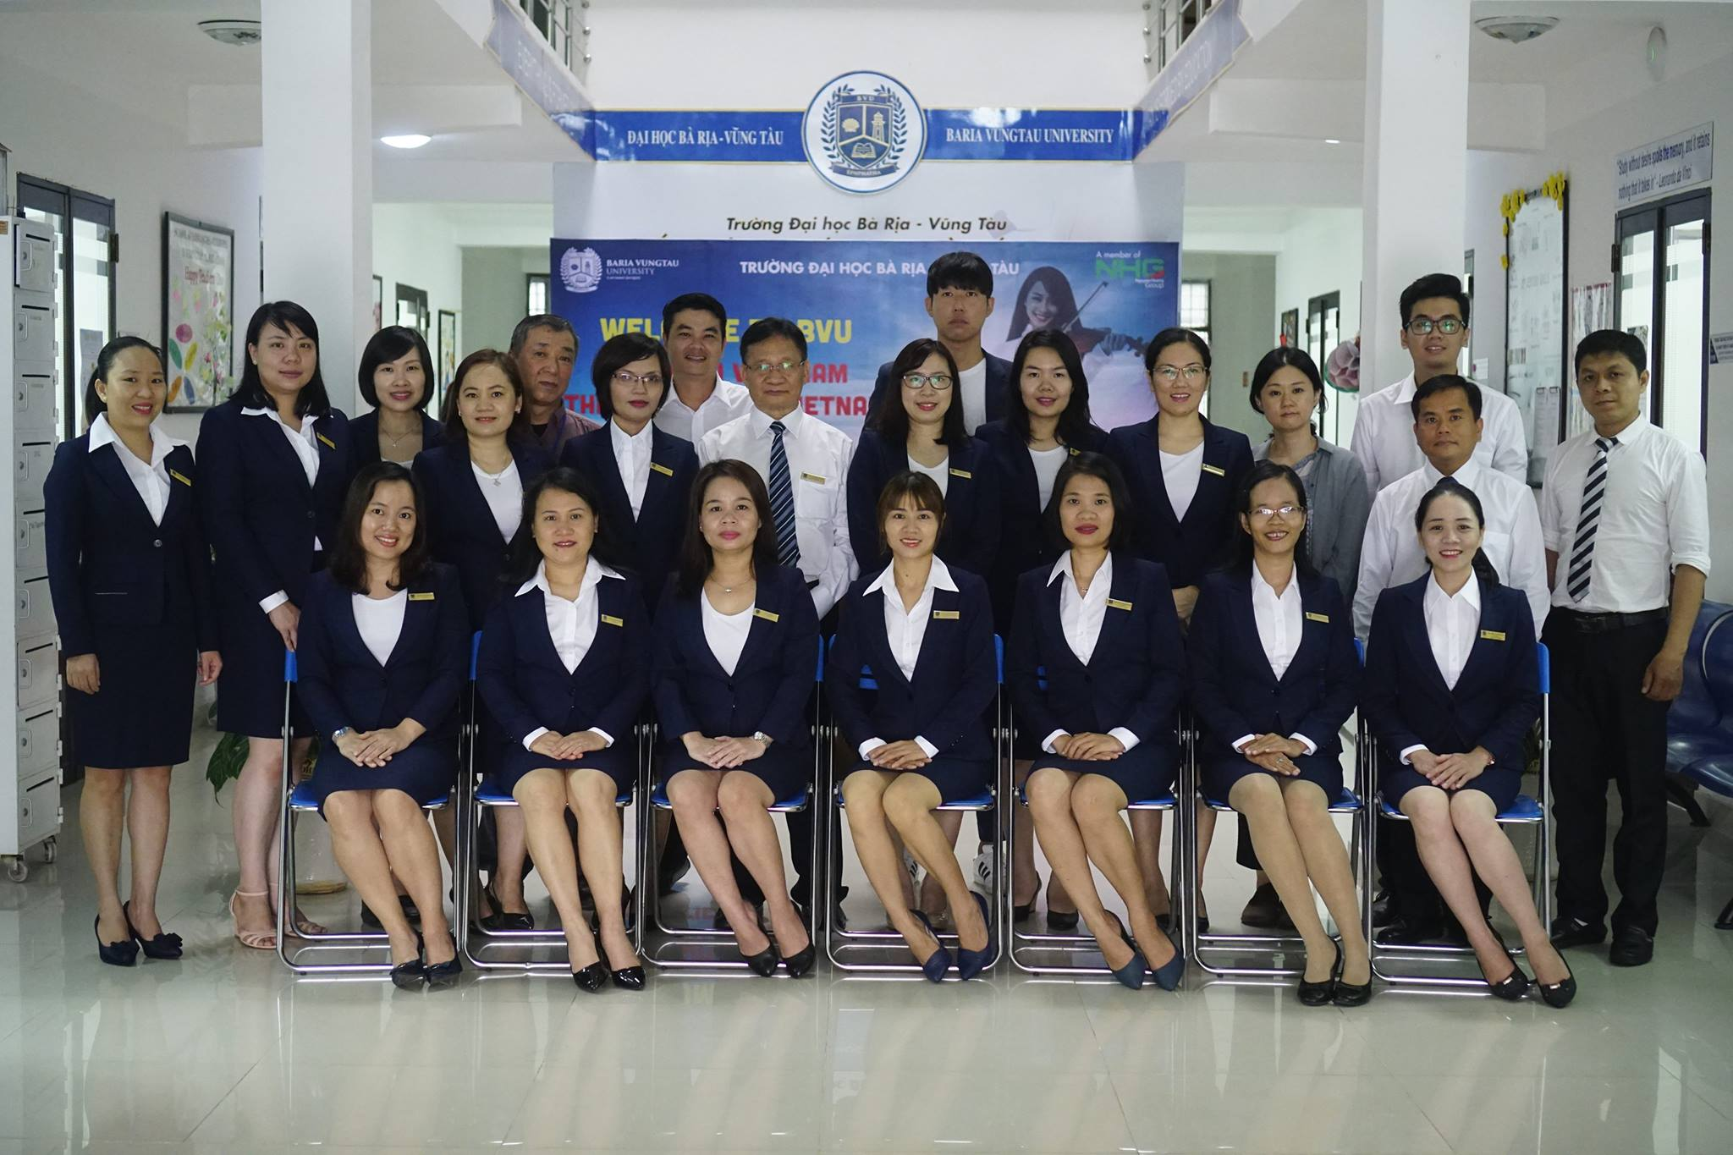

Slide 2
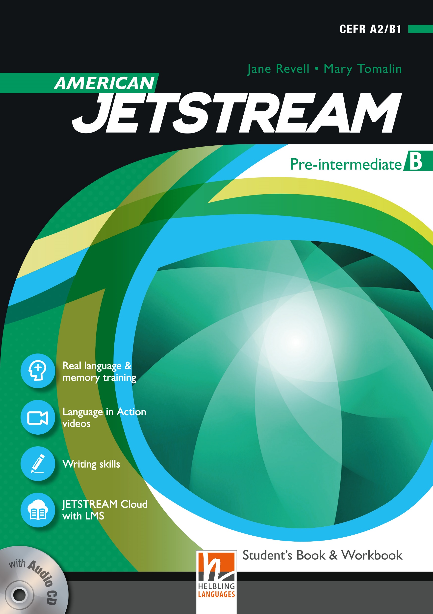
AMERICAN JETSTREAM PRE-INTERMEDIATE B

Slide 3
TEACHER’S PERSONAL INFORMATION
Name: Nguyen Thanh Loan
Facebook: Loan Nguyễn Thanh
Mobile number: 0942 255 937
Email: loannguyenthanh1978@gmail.com

Slide 4
Checking old lesson
Fill in the gaps with the correct words
1. ______ full of vitamins, minerals, and is the most nutritious vegetable.
2. _________is a grain. It is a complete protein. In other words, it has all the protein you need.
3. People who drink _______ everyday have less heart disease and cancer than other people.
4. _______ may prevent heart disease and eye disease in older people.

Slide 5
Checking old lesson
Fill in the gaps with the correct name of the countries.
5. In India and ______, people are expected to eat all the rice on your plate to show that you have enjoyed your meals.
6. In Egypt, Jordan, Cambodia, and_________, you should leave a little food on your plate.
7. In_______ , the food is usually eaten with a knife and folk.
8. In Pakistan, Arab, African culture and _______, food is often eaten with their hands.

Slide 6
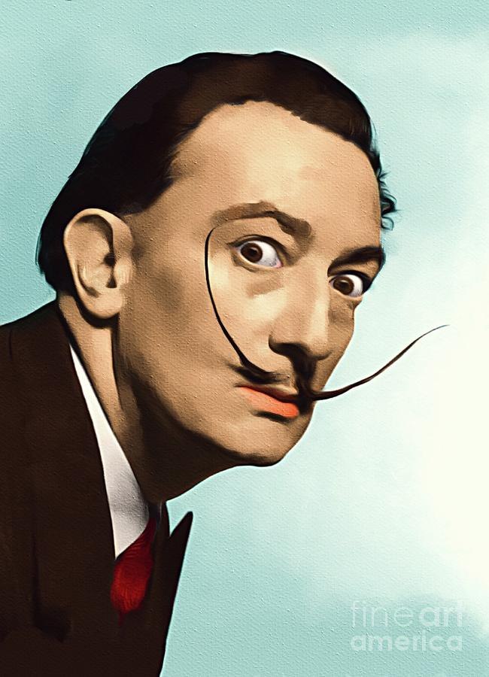
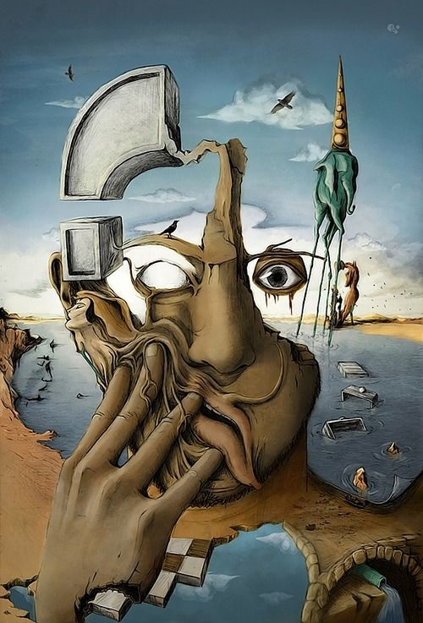
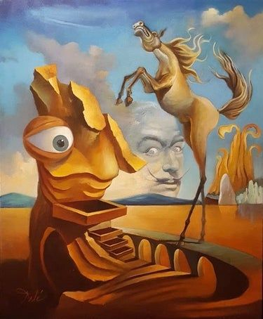
UNIT 11
Artists and writers
/ˈɑː.tɪst/
/ˈraɪ.tər/

Slide 7
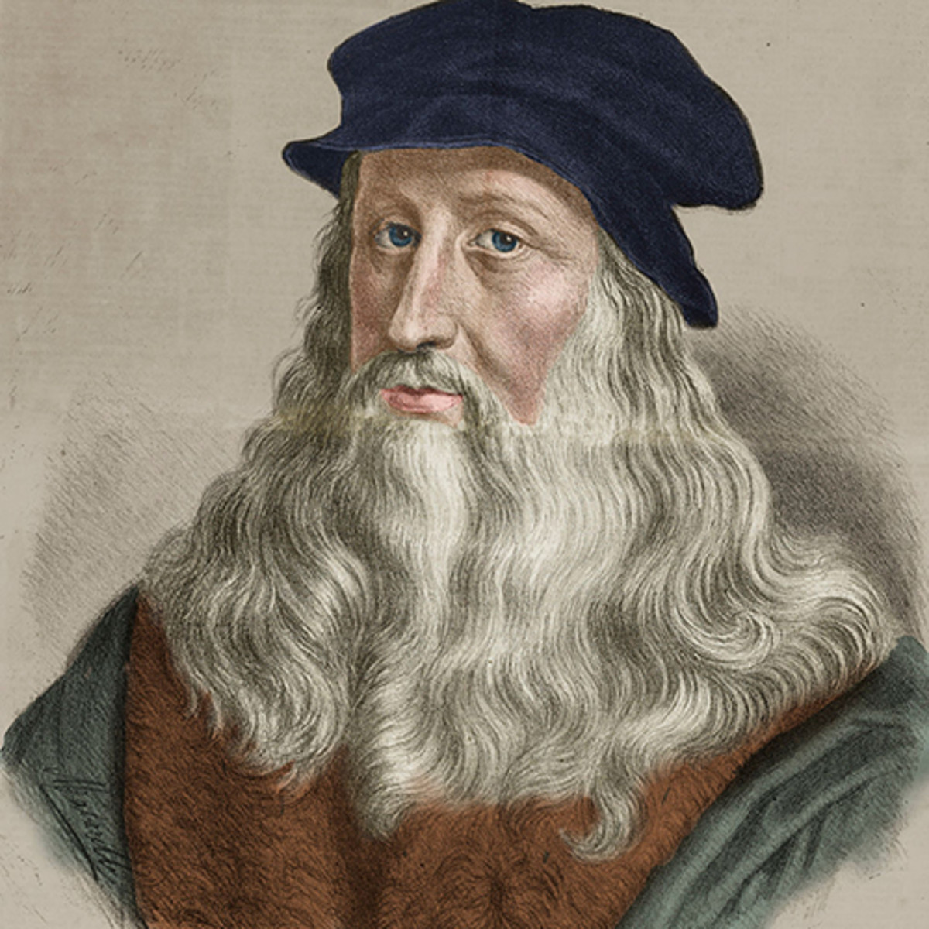
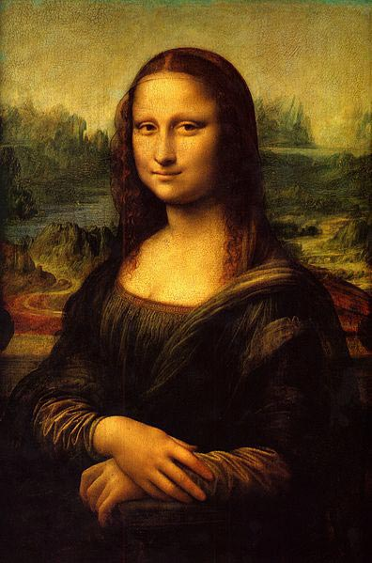
Artists
someone who paints, draws, or makes sculptures:
/ˈɑː.tɪst/

Slide 8
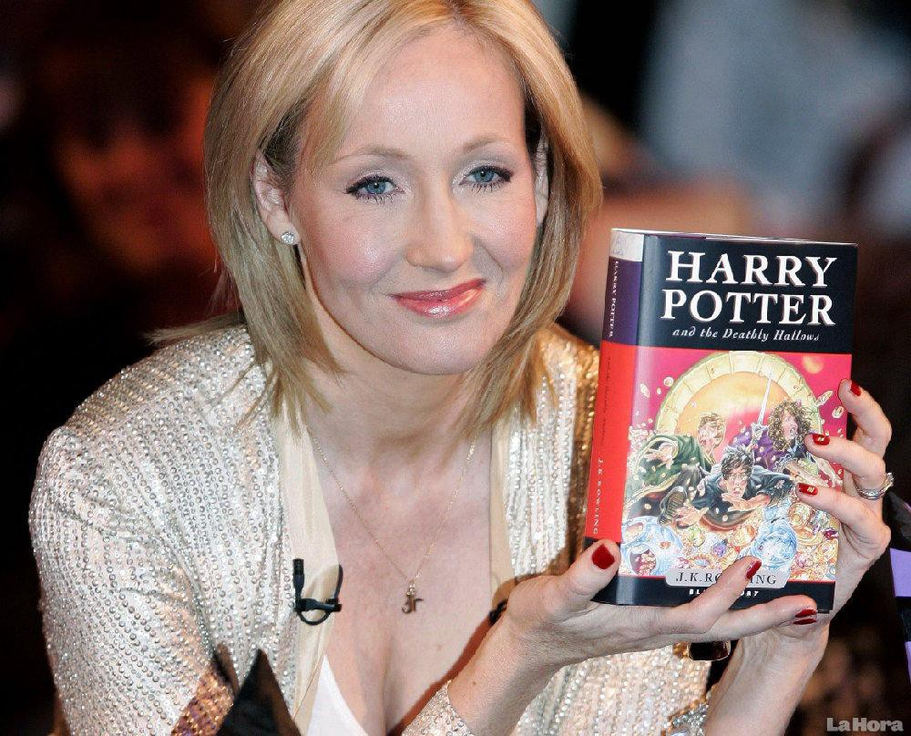
a person who writes books or articles to be published:
Ex: She is a well-known writer of children’s books.
writer
/ˈraɪ.tər/

Slide 9
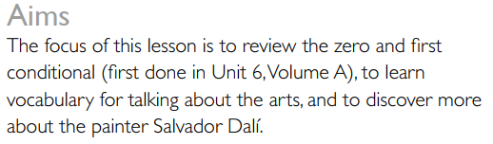
UNIT 11
Artists and writers
Lesson 1
What it really takes

Slide 10

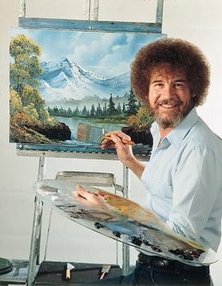
VOCABULARY
VERBS OF MOVEMENT
painter
a person whose job is painting buildings, walls, etc.
/ˈpeɪntə(r)/
Ex: He works as a painter and decorator.

Slide 11

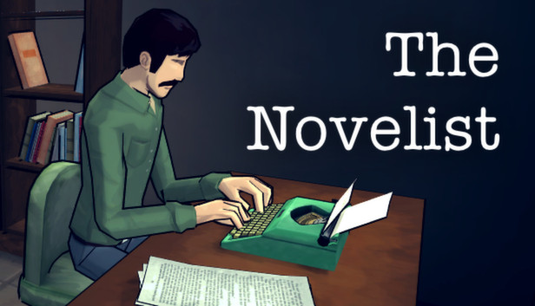
VOCABULARY
The arts
novelist
a person who writes novels
/ˈnɒvəlɪst/
Ex: His ambition is to become a best-selling novelist.

Slide 12
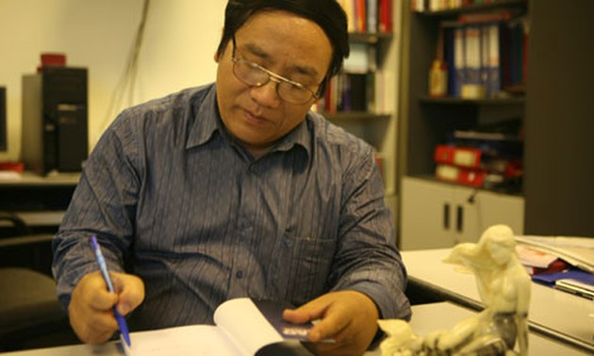

VOCABULARY
The arts
poet
​a person who writes poems
/ˈpəʊɪt/
Ex: Tran Dang Khoa is a poet of the children.

Slide 13
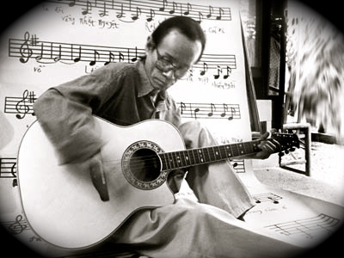
VOCABULARY
The arts
musician
a person who plays a musical instrument or writes music, especially as a job
/mjuˈzɪʃn/
Ex: Trinh Cong Son was a famous musician in Vietnam.

Slide 14
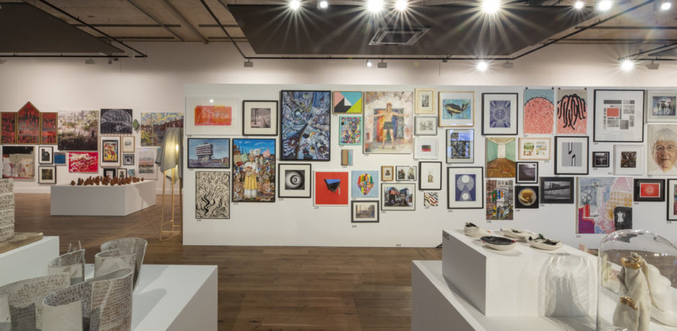
VOCABULARY
The arts
exhibition
a collection of things, for example works of art, that are shown to the public
/ˌeksɪˈbɪʃn/
Ex: Have you seen the Picasso exhibition?

Slide 15

VOCABULARY
The arts
Social media
websites and software programs used for social networking
/ˌsəʊʃl ˈmiːdiə/
Ex: Companies need to invest in social media to make it work for them.

Slide 16
VOCABULARY
Check the meaning of the words in your dictionary.
Mad sane creative difficult
success talented imagination ordinary
moustache fascinating

Slide 17
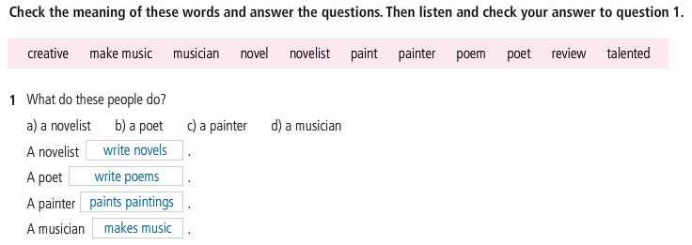

VOCABULARY
The arts

Slide 18
Discussion
Who is the most creative and talented person you know?
You should include:
his/her job.
His/her type of work and how they are.
His/her personality

Slide 19
Discussion
Trịnh Công Sơn always said : “ Writing a good song only needs the love to the music. My work is writing music, my hobby is always writing music”
He wrote about 600 songs. Many of Trịnh’s songs are love songs. Others are anti-war songs, written during Vietnam war. All of his songs have meaningful lyrics and the melodies are quite strange.
Unlike many other normal composers, Trịnh Công Sơn used many descriptive languages to express his feelings, he even used words that some Vietnamese cannot understand the meaning. Although he studied in French, his Vietnamese vocabulary is unlimited. He composed words perfectly, his music was simple but it turned into masterpiece.

Slide 20
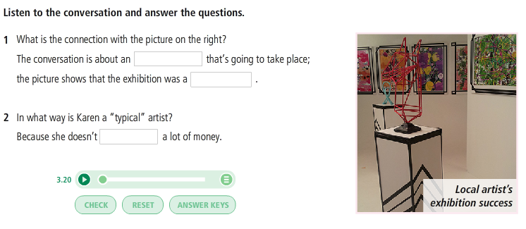
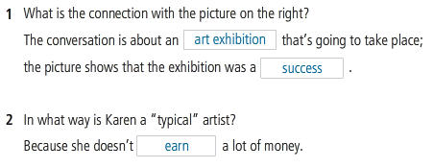
Listening
The arts

Slide 21
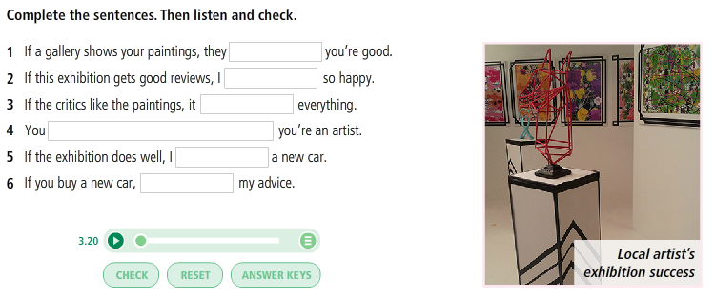
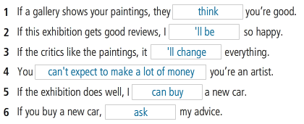
Listening
The arts

Slide 22
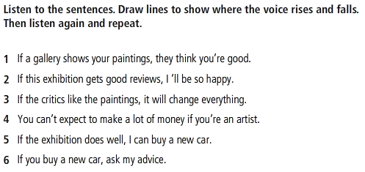
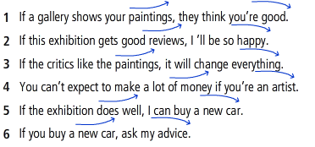
Listening
The arts

Slide 23
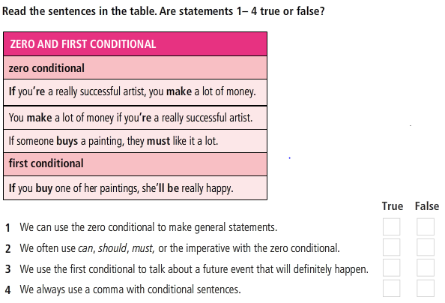
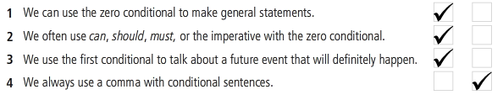
GRAMMAR
Zero and first conditional

Slide 24
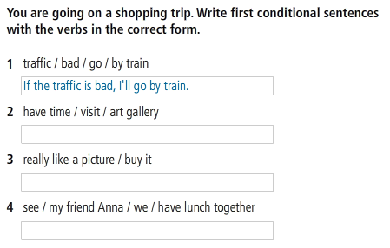
GRAMMAR
Zero and first conditional

Slide 25
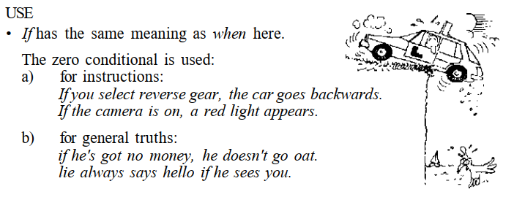
GRAMMAR
Zero conditional

Slide 26
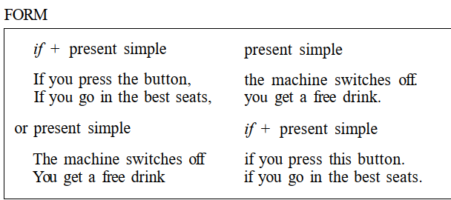
GRAMMAR
Zero conditional

Slide 27
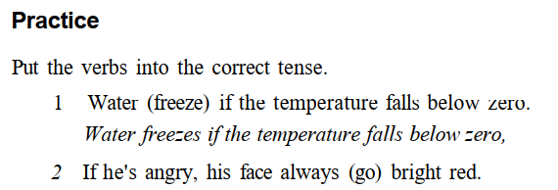
GRAMMAR
Zero conditional

Slide 28
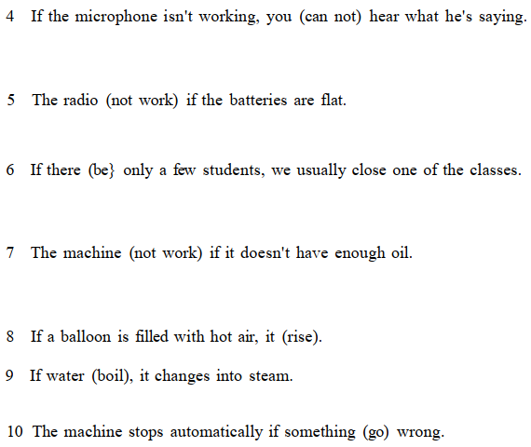

Slide 29
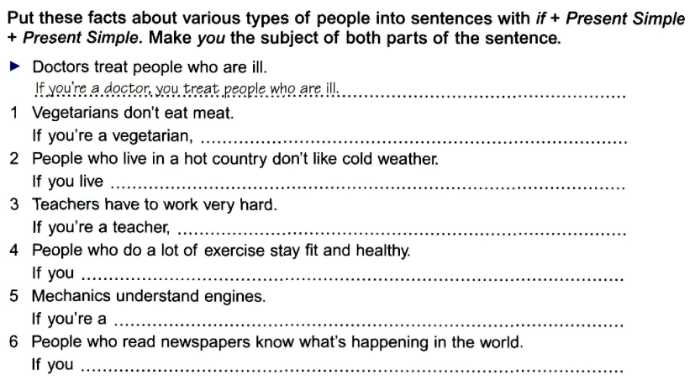
GRAMMAR
Zero conditional

Slide 30
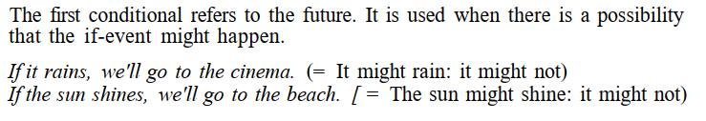
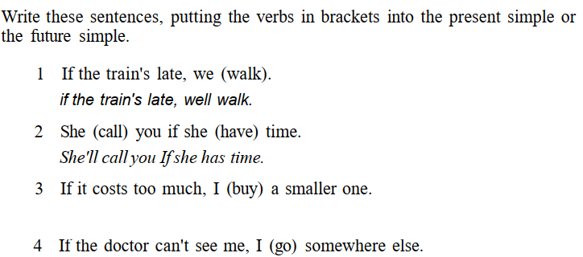
GRAMMAR
First conditional

Slide 31
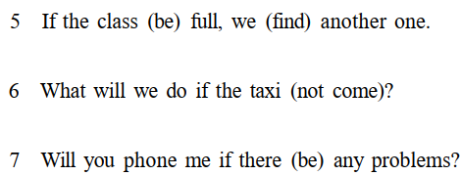
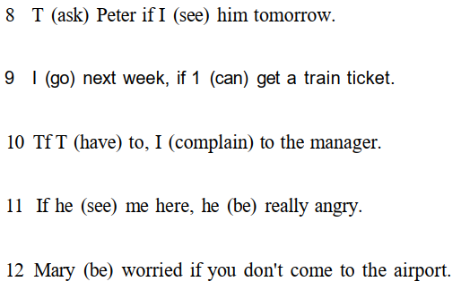

Slide 32
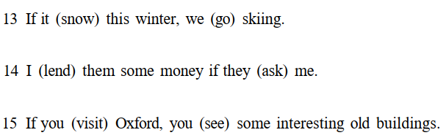

Slide 33
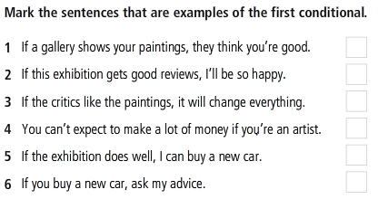
GRAMMAR
Zero and first conditional

Slide 34
Speaking
Think of many things that may happen to you in the future. (using the first conditional).

Slide 35
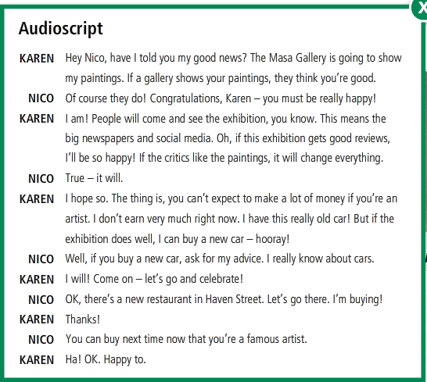

Slide 36
REFERENCES
Vocabulary: The arts
https://www.youtube.com/watch?v=Yq_p9C04wuM
Grammar: Zero conditional
https://www.youtube.com/watch?v=r7UW7EJuR3o
https://www.youtube.com/watch?v=ndNAp0c8UoE
https://www.youtube.com/watch?v=GG0PZAk4ZA8
Grammar: First conditional
https://www.youtube.com/watch?v=s59ygVYxpag
https://www.youtube.com/watch?v=ZluE8MUNe0Y

